Slide 1
MGMT310
Organization Mission and Vision Statement
Joshua Motzer 10/17/2021

Slide 2
Table of contents
What is a mission statement
What is a vision statement
How do mission and vision relate to the organization strategy
Why I s creativity relevant to mission and vision.
References

Slide 3

Mission, Vision, and Values
Notes:
An example of Mission, Vision, and Values of an organization. These lay the foundation for members and the company. This also reinforces team development and creates a sense of purpose for employees as they strive to meet the both short and long term goals.

Slide 4
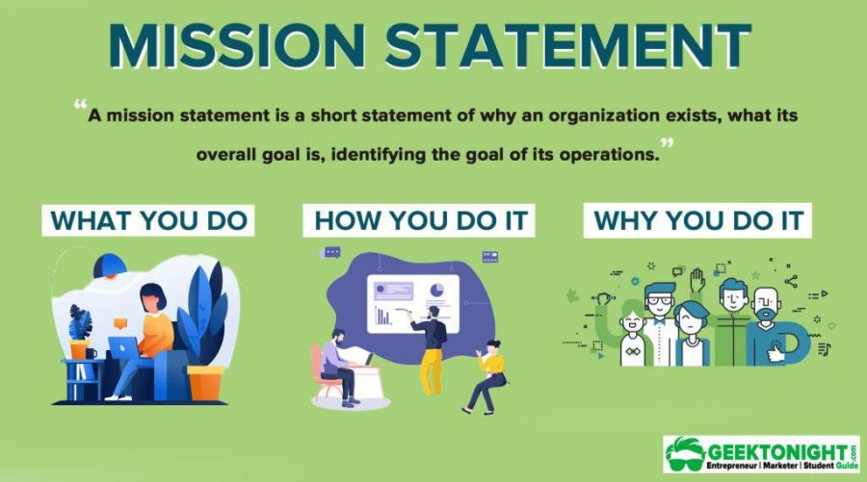
Mission statement
A mission statement is used by a company to explain, in simple and concise terms, its purpose(s) for being. The statement is generally short, either a single sentence or short paragraph
Notes:
Mission statements are concise statement that gives all of its members a shared purpose for the organization. In essence it is the reason the company exists. It provides a pathway forward and it what separates this organization from others.
A good mission statement should answer two questions. Why does it exist and how are they different from others. This is what sets you apart and allows members to understand what direction they are taking.
Advantages- it outlines goals and position in the industry fr4o its customers and stakeholders.
Disadvantage- Sometimes mission statements my sometimes be very lofty and far to unrealistic which can distract employee from the companies goals.

Slide 5

Vision statement
The vision statement describes what your company aspires to be and what it wants to achieve. It inspires and challenges the employees
Notes:
A 2018 Employee Retention Report by Tiny Pulse suggests that employees are 27% more likely to stay in an organization that has broader goals outside of profit margins ("Why mission statements matter," n.d.).
Should be short and not to drawn out.
The vision statement is the purpose and the being of the company. It also promotes the growth of the company. If the company vision and mission statements are written wisely the can help drive the goals of the organization.
Vision statements need to realistic and attainable. If this is unrealistic you will not be able to meet your goals. Constantly refining your vision statement will ensure it is attainable.

Slide 6
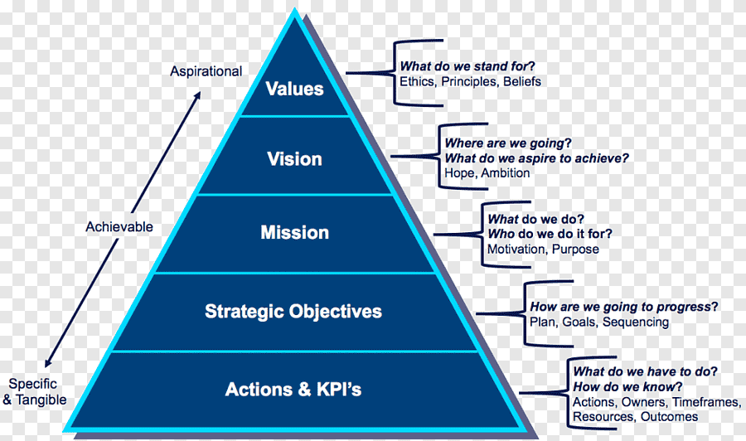
Organizational strategy
Mission and Vision relate to an organizational strategy by showing how they are going to progress. What the plan, goals and sequencing are going to be.
Notes:
Mission and vision both relate to an organization purposes and are typically communicated in written form. Mission and vision are statements from the organization that answer questions about who we are, what do we value, and were we’re going. Mision and vision create a target for strategy that drives investment and imagination for both employees and customers.
Mission and vision statements play three critical roles: (1) communicate the purpose of the organization to stakeholders, (2) inform strategy development, and (3) develop the measurable goals and objectives by which to gauge the success of the organization’s strategy. These interdependent, cascading roles, and the relationships among them, are summarized in the figure (Bauer et al., 2017, p. 85)

Slide 7
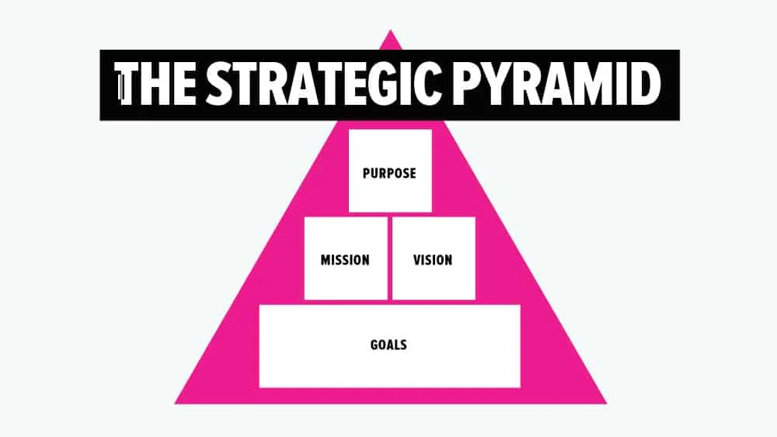
Relevance to creativity
Creativity plays a key role in defining your mission and vision statement. You have to be different from others to distinguish your brand.
Notes:
Creativity is defined as the generation of new ideas. Being able to critically think about the strategic direction of the company will allow you to generate new ways of achieving that goal. Being creative gives the organization an outlet to define how they want to be viewed by their employees and customers.
Purpose – The reason you exist beyond making money (Never changes)
Mission – A master plan for creative value (5-20 years)
Vision – A shared picture of Mission success (5-20 years)
Goals – Short-term objectives that support your Mission and Vision (1-5 years) (Cass, 2020)

Slide 8
References
How to write your mission, vision & values (In the next 24 hours). (2021, March 23). Smemark. https://smemark.com/mission-vision-values/o write your mission, vision & values (In the next 24 hours). (2021, March 23).
Why mission statements matter. (n.d.). Investopedia. https://www.investopedia.com/terms/m/missionstatement.asp
Bauer, T., Short, J., Erdogan, B., & Carpenter, M. (2017). Principles of management 3.0. Flat World Knowledge, Inc.
Cass, J. (2020, May 7). The strategic pyramid - Brand purpose, mission, vision & values. JUST™ Creative. https://justcreative.com/the-strategic-pyramid

